Slide 1
Regional opportunities in smart tourism
Eva Cipi
RDC University Ismail Qemali Vlore

Slide 2
Regional development centre
A sustainable product by European projects

Slide 3
Third mission of UV activities
RDC objective
  To promote the best products and services from research and innovation activities at each faculty.
  To organize promotional events involving company leaders, public administration or other specific sectors.
  To encourage scientific and innovative work of academic staff focused on the real needs of the market and economy.
  To create a new profile of the university of vlora
  To work on projects and innovation for more European funds

Slide 4
Projects
U3M
  Developing third mission of Albanian universities
  Under tempus programme
  Foundation of RDS CENTRE
GREEN TECH
  Under Erasmus Mundus
  Mobility of academic and administrative staff,
  Mobility of students
TEAVET
  Developing a teacher training VET comprehensive system in Albania
  RDC- including LLL centre for teacher qualification
Business clubs
  Interreg cross border AL GREECE
  Creation of 5 placement at UV library for entrepreuner young people
SESC
  Interreg IPA cbC IT-AL –Me
  Smart energy in smart cities

Slide 5
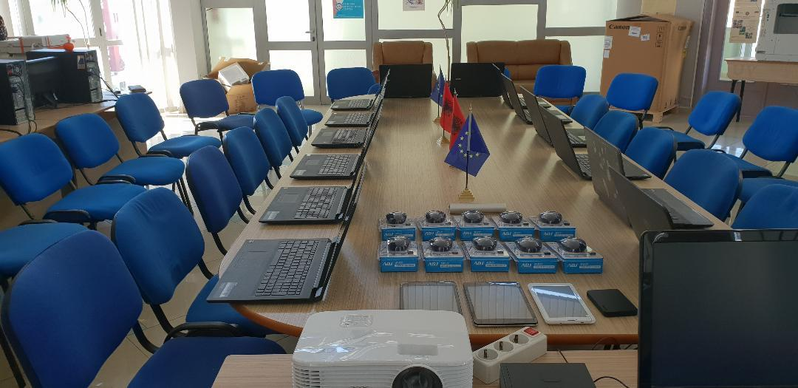
LLL centres establishment

Slide 6
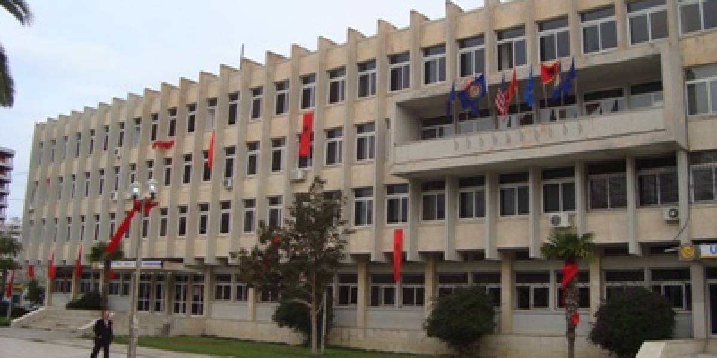
University of Vlora an active regional partner

Slide 7
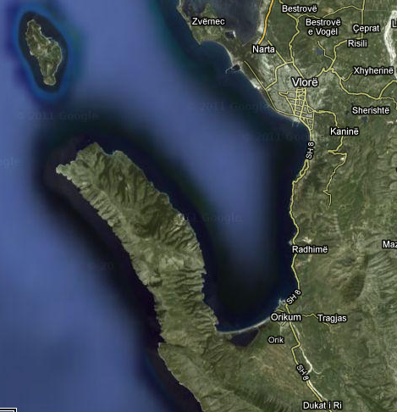
V
L
O
R
A

Slide 9
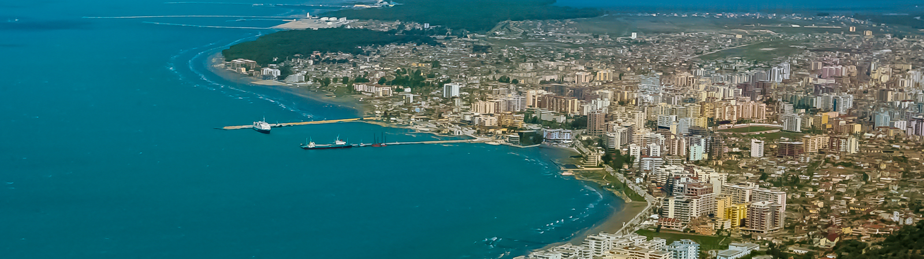
Vlora - a touristic city
UV MAIN BUILDING site

Slide 10
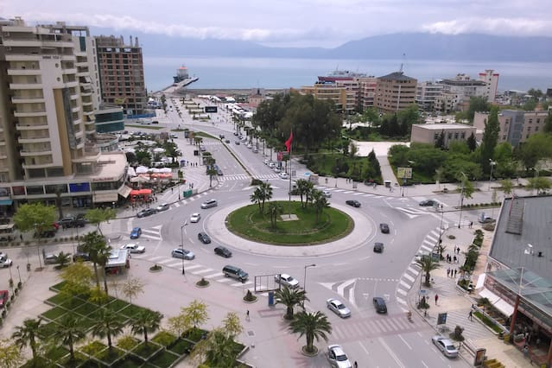
ADDRESS: Skela Square

Slide 11
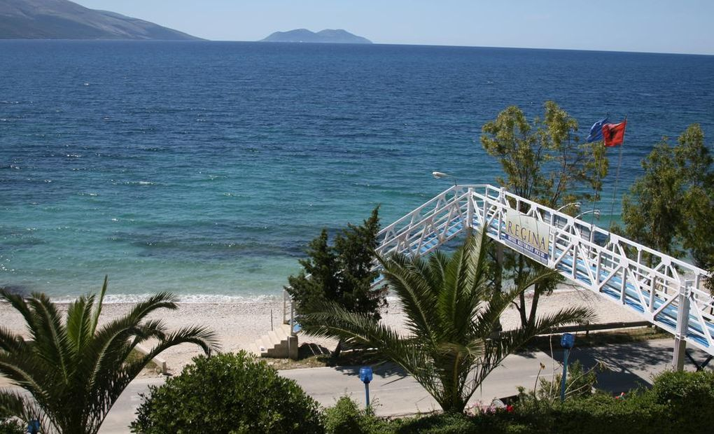
Beaches: main resources of tourism and economy

Slide 12
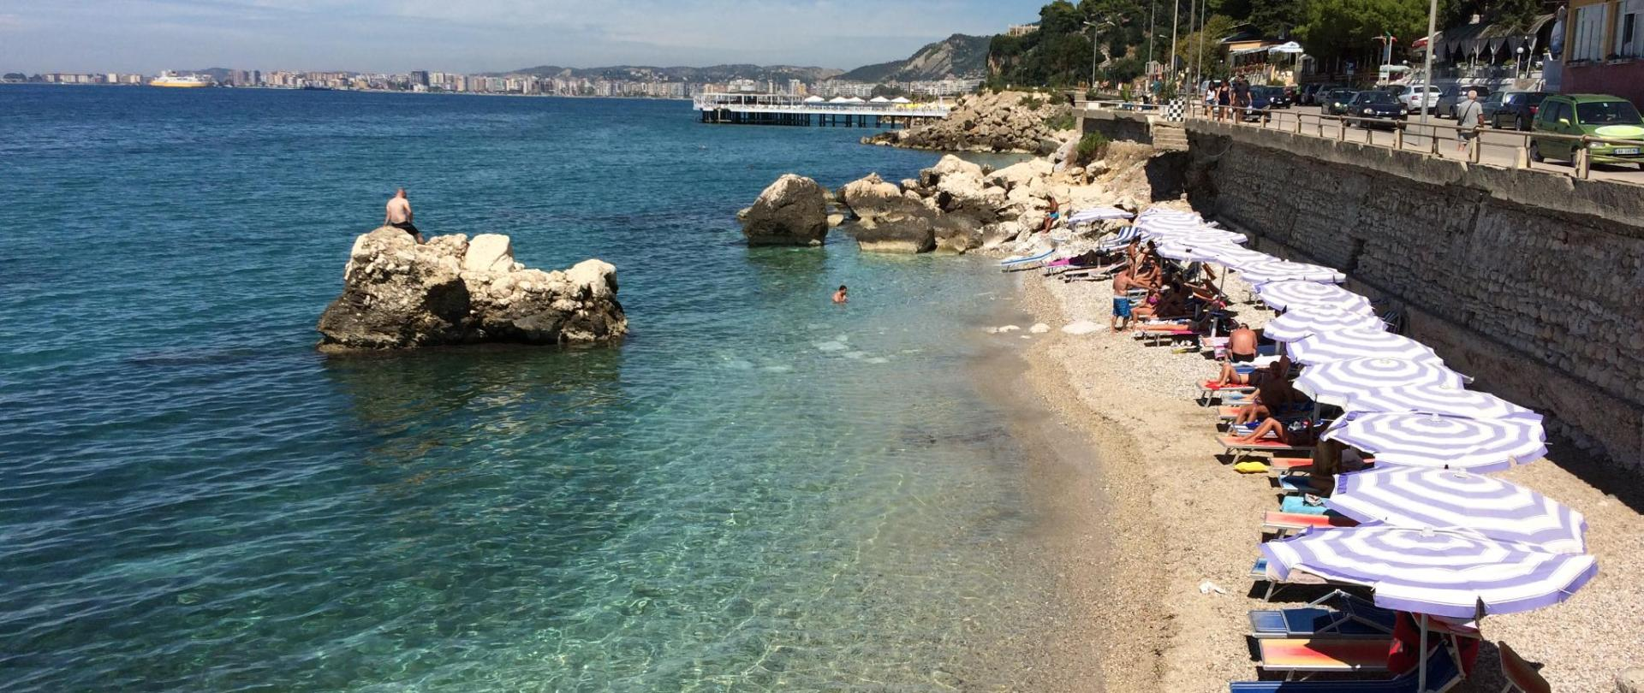

Slide 13
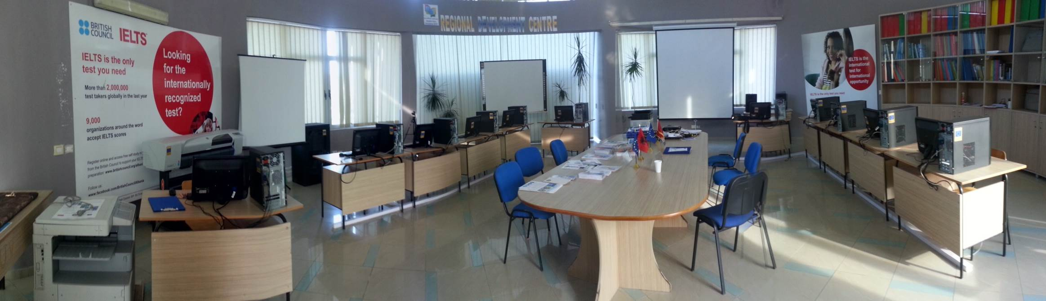
Location of projects Team

Slide 14
Smart tourism – one definition
A word applied to describe the increasing reliance of tourism destinations, their industries and their tourists on emerging forms of ICT that allow for massive amounts of data to be transformed into value propositions.

Slide 15
smart fields related
Smart Data - used for operational real-world data, integrating and sharing data, and using modelling, optimization and visualization to make better operational decisions.
smart city - to describe efforts aimed at using technologies in an innovative way to achieve resource optimization, effective and fair governance, sustainability and quality of life.
Smart home, smart factory - blurring the lines between the physical and the digital things and on fostering technology integration.
Devices - smart phone, smart card, smart TV, etc. describes multi functionality and high levels of connectivity.
Markets /economies (smart economy), it refers to technologies supporting new forms of collaboration for innovation and entrepreneurship

Slide 16
In the context of tourism
Smart is used to describe a complex of all of the them
Fact!
There is incredible institutional support and in some instances even pressure to realize smart tourism.

Slide 17
What governments universally recognize
Especially in Asia, many efforts to drive the smart tourism agenda forward.
  Governments in China and South Korea - focused on building the technological infrastructure that supports smart tourism.
The focus in Europe, however, is more
  on innovation and competitiveness developing smart end-user applications that support enriched tourism experiences using already existing data combined and processed in new ways
In Australia, the focus is on smart governance and open data.
What governments universally recognize is
  the transformative power of smart technologies not only in terms of the economic potential but also the social dimensions.

Slide 18
in practice - smart tourism
used to drive specific political agendas and to sell technological solutions.
frequently used in the context of open data initiatives or for simple projects such as promoting free Wi-Fi or the development of mobile applications.
While these technologies are important steps in implementing smart tourism, they do not provide the full picture of what smart tourism should be.

Slide 19
lack of definition
  Limited at
  For many government and industry - led projects.
  Academic work is largely focused on describing the phenomenon in the form of case studies
  Discussing isolated technological developments
  Laying the theoretical foundations for its advancement and/or critique.
  Research needs to be met in order to inform the future development of smart tourism

Slide 20
New Definition of smart tourism
Tourism is social, cultural and economic phenomenon which entails the movement of people to countries or places outside their usual environment for personal or business/professional purposes
Adding
ICT - intensity of tourism and the high dependence on information and communication technologies
smart tourism can be seen as a logical progression from traditional tourism and e-tourism.
The integration of web-based technologies that led to the emergence of e-tourism.

Slide 21
This development trajectory of ST
This development trajectory continued with
  the widespread adoption of social media
  realizing mobile tourism
  evolution of ICT in tourism
  physical and governance dimensions
  new levels of intelligence are achieved in tourism systems
  the ways in which smart tourism approaches are created, exchanged and shared are fundamentally different.

Slide 22
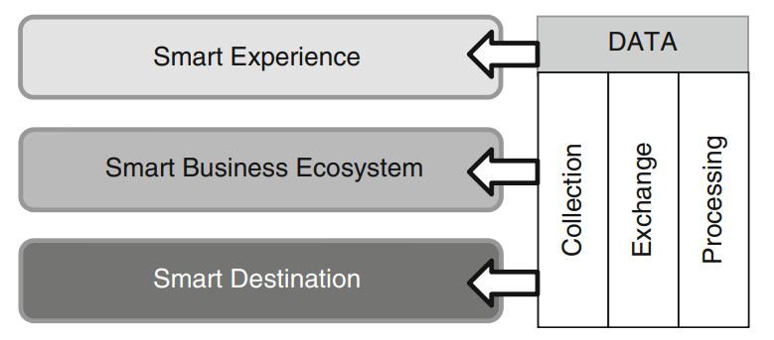
components

Slide 23
1- Smart tourism destination
An innovative tourist destination, built on an infrastructure of state-of-the-art technology guaranteeing the sustainable development of tourist areas, accessible to everyone, which facilitates the visitor’s interaction with and integration into his or her surroundings, increases the quality of the experience at the destination, and improves residents’ quality of life.

Slide 24
SMART DESTINATIONS
refers to smart city principles to urban or rural areas and not only consider residents but also tourists in their efforts to support
Mobility,
Resource availability and allocation,
Sustainability and quality of life/visits.

Slide 25
ICT role in smart entities
Digital transformation
Digital innovation
Digital empowerment
Case – Barcelona City

Slide 26
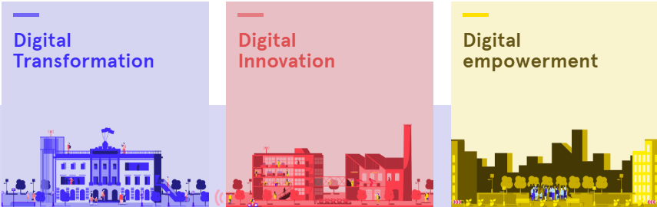


Slide 27
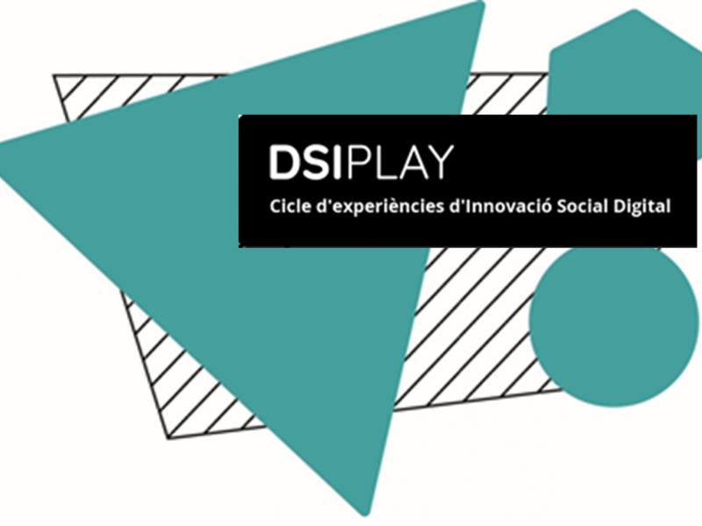
Example of projects - DSIPLAY
Objectives-
Developing a cycle of digital social innovation experiences open to the public
The purpose
Ensuring that the technological revolution has a positive impact on both citizens and the city as a whole.
Raising awareness of the most important social innovation projects ,

Slide 28

Rec, the citizen coin
Objectives
Economic resource to create a complementary and peer-to-peer citizen exchange system in the euro.
The local currency acts as a complementary form of payment without replacing the national one. At the same time, it gives the opportunity to measure the impact of consumption in the city.
It is estimated that more than 5,000 people already use one of the 70 local currencies in Spain.

Slide 29
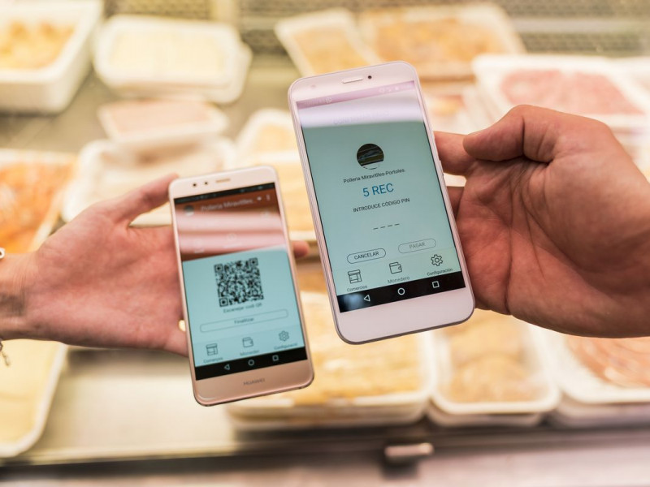
REC application

Slide 30
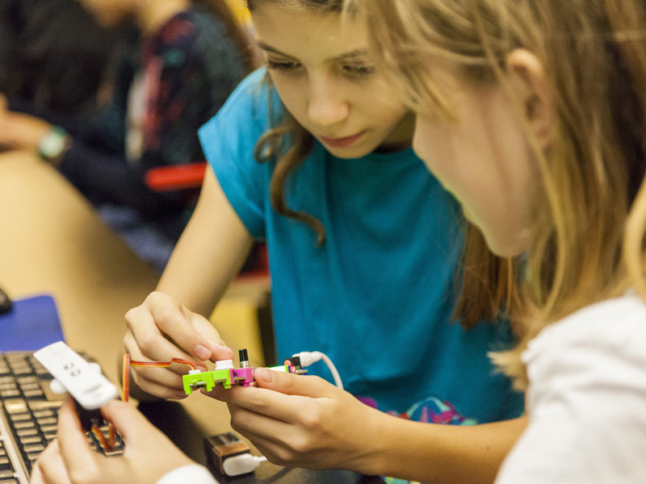
STEAM BCN
Objectives
The project focuses on the gender perspective and the demystification of the figure of the scientific person linked to a socio-economic profile and status.
Based on workshops, training capsules, visits to research centers, ideatons , etc.
Have been designed actions that take place in schools, libraries, universities.

Slide 31
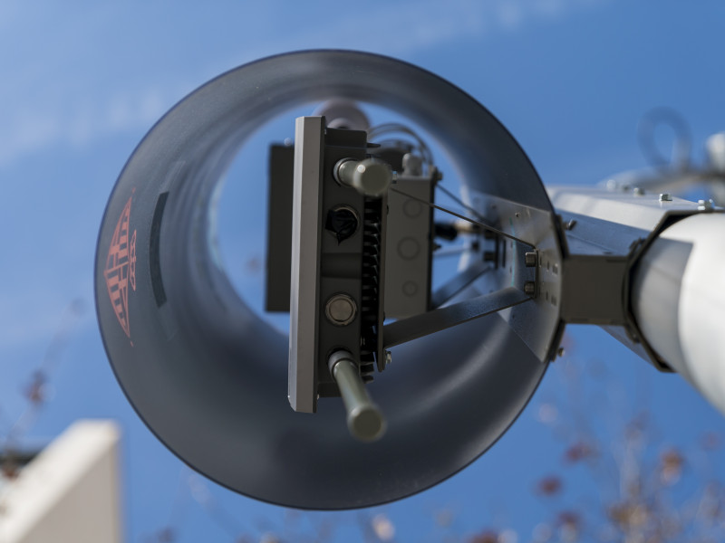
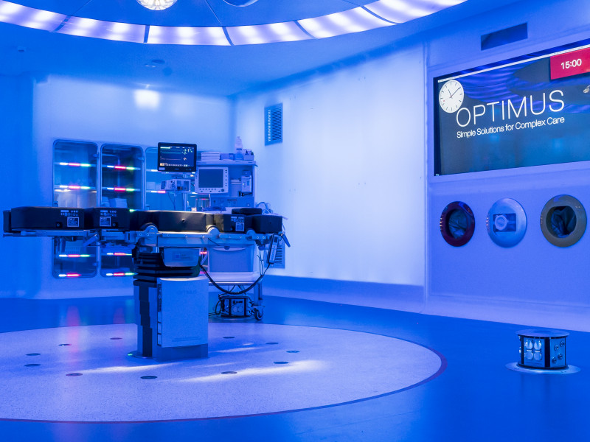
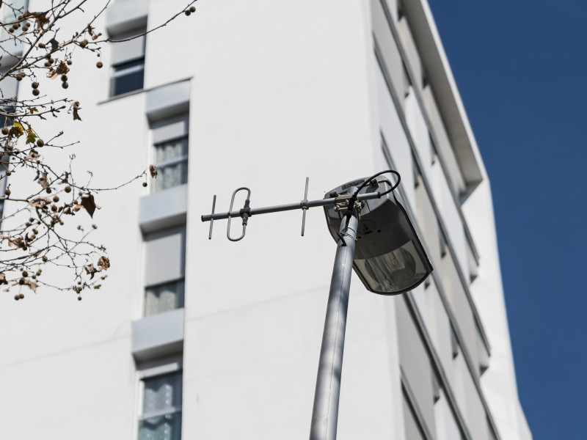
5G Barcelona
Objectives
The city will be the 5G hub in Southern Europe.
The government of Catalonia, and other partners have launched the 5g barcelona initiative to make Catalonia an European 5g digital hub .
In addition, 5g Barcelona - an European 5G digital hub based on an experimental infrastructure open to the metropolitan area, which acts as an urban, citizen and technological laboratory for the validation of 5G technologies and services.
Being an open innovation environment based on the collaboration between different actors, both public and private, ​​which will help attract foreign investment, promote technology start-ups and develop an industry around 5g.

Slide 32
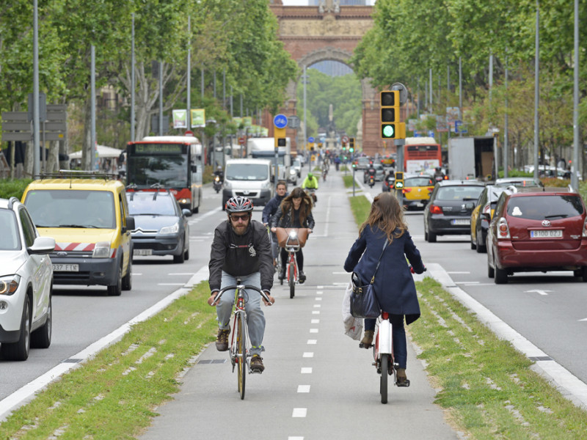
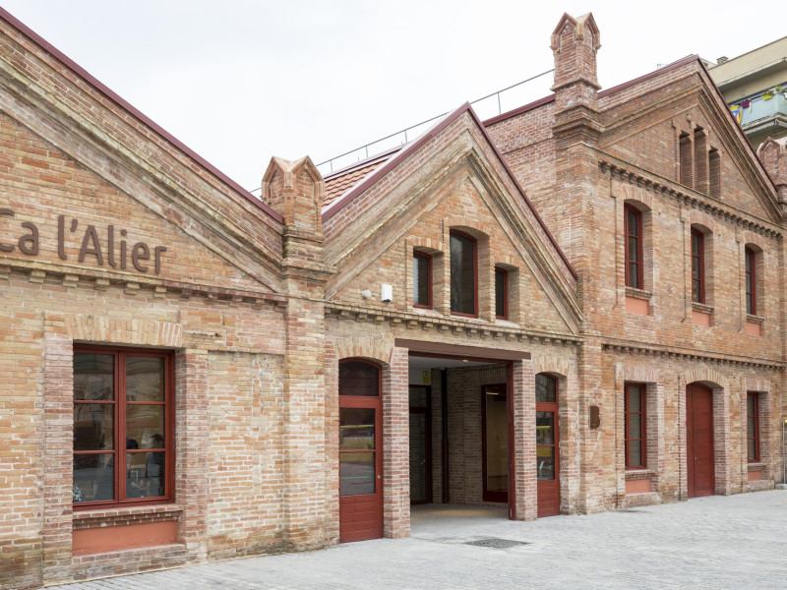
KIC Urban Mobility
Objectives
Technological innovation to address the challenge of urban mobility.
Urban mobility is one of the priority challenges for all governments, if not the most important.
To carry out this macroproject, the mobilus consortium has been created , consisting of 48 cities from 15 countries, 12 companies and 18 universities - such as the Polytechnic of Catalonia and seat-. Between all the partners it has been proposed to rethink how to more efficiently invest in public resources in the field of mobility.
The headquarters of mobilus are Ca l‘Alier , in the district of Sant Martí. The superblocks, the reconfiguration of the bus network, the increase of the cycling infrastructure in the city,

Slide 33
2- The smart experience
To including a destination component, smart tourism is a social phenomenon arising from the convergence of ICT with the tourism experience
The smart experience component specifically focuses on technology-mediated tourism experiences and their enhancement through personalization and real-time monitoring identify information aggregation, and real-time synchronization as the major drivers of such smart tourism experiences.
The smart tourism experience is efficient and rich in meaning. Tourists are active participants in its creation. They not only consume but also create, annotate or otherwise enhance data that constitutes the basis of the experience
Examples.
  By uploading photos to instagram with destination-related hashtags or helping map toilets at destinations - http://www.Nyrestroom.com/
  the smart tourists and their digital selves (or data bodies) use smartphones to tap into information infrastructures provided at the destination or virtually in order to add value to their experiences.

Slide 34
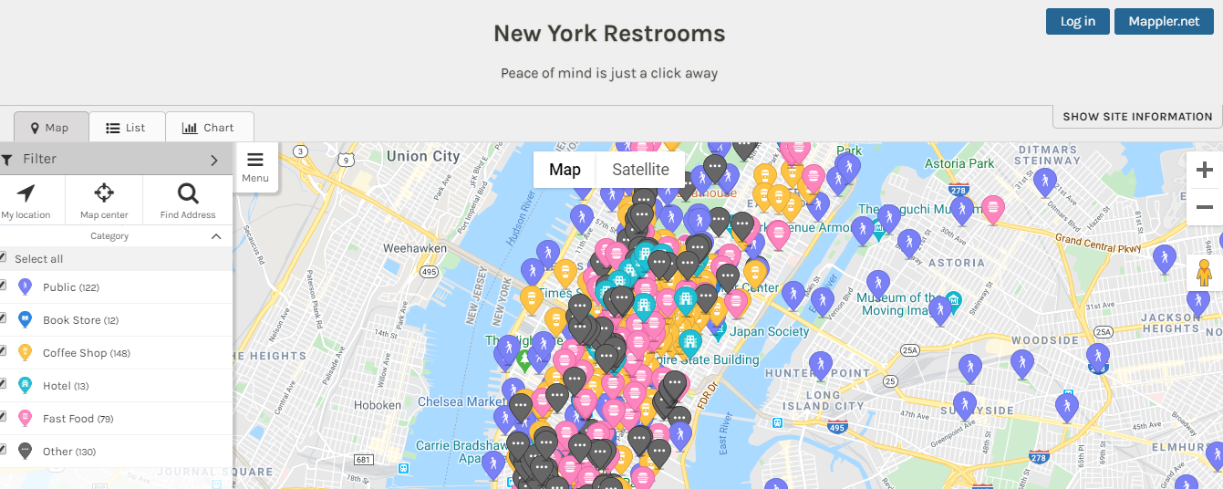
  http://www.Nyrestroom.Com/

Slide 35
3- Smart Business
The third component
  Refers to the complex business ecosystem that creates and supports the exchange of touristic resources and the co-creation of the tourism experience.
  The business component of smart tourism means interconnection of stakeholders, the digitalization of core business processes, and organizational agility.
It includes public-private collaboration becoming more open and technology-focused as providers of infrastructure and data.
smart tourism recognizes that consumers can create and offer value as well as monitor and take on business or governance roles.

Slide 36
SMART TOURISM Layers
Importantly, smart tourism spans three layers across these three components:
  a smart information layer that aims at collecting data;
  a smart exchange layer that supports interconnectivity;
  a smart processing layer that is responsible for the analysis, visualization, integration and intelligent use of data

Slide 37
Technological foundations of smart tourism
ICT is the key to the development of smart tourism.
ICT has the ability to support tourism in an intelligent way
Smart ICT is expected to be able to comprehend, to profit from experience, to acquire and retain knowledge, and to respond quickly and successfully to a new situation
Within a smart tourism setting, information systems promise to supply tourism consumers and service providers with more relevant information,
These smart systems include a wide range of technologies in direct support of tourism

Slide 38
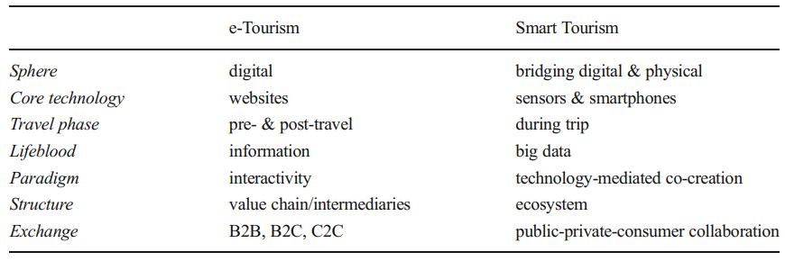
E-tourism vs Smart Tourism

Slide 39
The internet of things (IoT)
realizing the internet of things (IoT) for creating the desired smart technological environment that includes connected physical and digital infrastructures.
the internet of things has the potential to rapidly become a new reality as a technological infrastructure
The basic idea of the IoT is the presence around us of a variety of objects such as radio-frequency-identification (RFID) tags, sensors, actuators, mobile devices, etc., which are able to interact with each other and cooperate with their neighboring objects to achieve common goals
the IoT enables the development of various platforms able to transmit a wide range and various types of data using participatory sensing systems

Slide 40

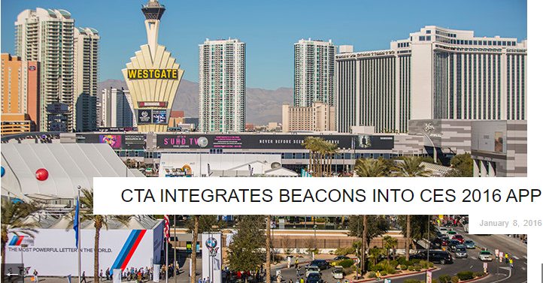
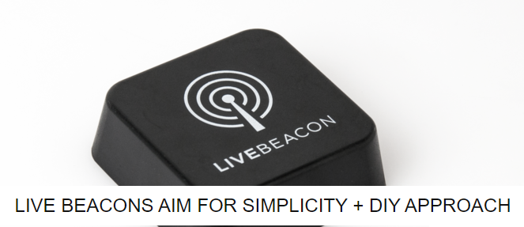
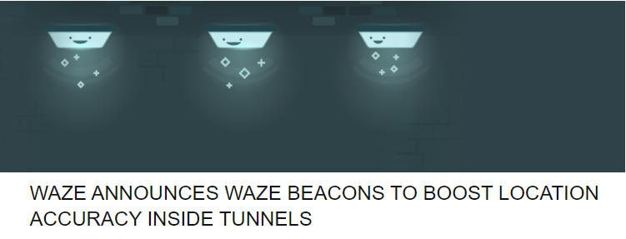
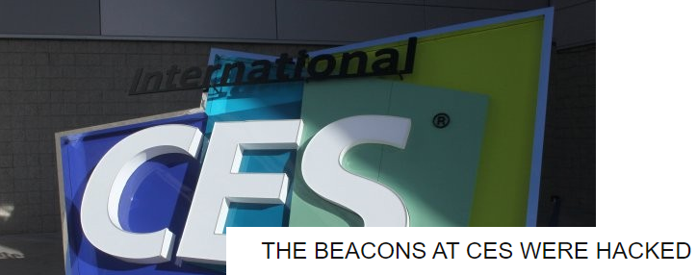
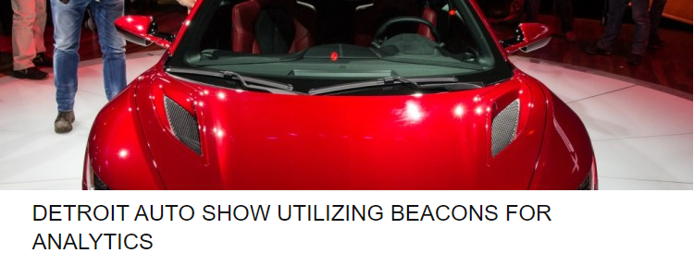
ibeacon technology
Ibeacon is apple's implementation of bluetooth low-energy (BLE) wireless technology to create a different way of providing location-based information and services to iphones and other IoT devices.
The increasing use of ibeacon technology in tourism ensures a first step in this direction in that it allows smart phones to react to signals from the physical world in order to support ambient context identification www. Ibeaconinsider.com

Slide 41
Innovations using IoT
The innovations driven by the IoT have important implications
for tourism development because travel involves movement through time and space and this smart environment will grow to be aware
sensors embedded in tourist attractions will enable tourism service providers to track tourists’ locations
technologies such as smart watches play an important role in collect data through their sensors and cameras communicate with the network , support high levels of connectivity without interfering with the experience.
control visitor numbers within specific tourism sites by using a variety of sensors with each site’s carrying capacity as a benchmark.
smart objects embedded in the environment may automatically trigger the transmission of messages to family and friends to enable them to know what we are doing or what we have done in the past
IoT as a platform that generates information about ‘events’ of people and places which is gathered and uploaded to provide information about travelers within their social networking sites.

Slide 42
Business foundations of smart tourism
ICT tools and applications have enabled tourism businesses to become ‘smarter’ in how to increase their performance and competitiveness by
  (hyper)-automating information
  transforming their business functions and processes
ICT have also an instrumental role in driving institutional and structural market changes in the tourism industry.

Slide 43
New business models for smart tourism
To survive, traditional tourism organization have to redefine their business model and the way they propose to create customer value.
By introducing new business models, firms develop new models
Smart tourism - means changing all or some of the following five market elements:
  exchange object,
  market actors,
  market structure,
  market institutions
  market practices.
Smart tourism affects smart environment in all nine elements of business models in fundamental ways: 1) customer segments; 2) value propositions; 3) channels; 4) customer relationships; 5) revenue streams; 6) key resources; 7) key activities; 8) key partnerships; and, 9) cost structure. T

Slide 44
Service science for Smart tourism
a functioning service ecosystem is seen as a major prerequisite for enabling the co-creation of customer experiences
Resources that actors may use and exchange in a smart tourism ecosystem can relate to the following types:
  tangible or intangible resources ( Tools, software, and information);
  human resources ( Skills, knowledge, and virtual communities); and
  relational ones (Relations to partners and suppliers, and network membership).
In a smart service ecosystem, any stakeholder is an actor aiming to interact and exchange resources with other actors for value co-creation.

Slide 45
implications for research
a major area of research necessary in the context of smart tourism is
  information governance and privacy, with particular questions relating to determining the value of information and ensuring safety and security in rather open and ubiquitous info-structures.
Why?

Slide 46
The main research areas identified
in the context of smart tourism is the extreme technology-dependence.
information overload - an increasing desire to escape technology when on vacation
While research is already being conducted on how technology enhances tourism experiences, there is a clear lack of research focusing on potential drawbacks of too much mediation.
critical perspective on smart tourism experiences, more information on psychological and health risks of constant bombardment with data by context-aware systems and insights regarding consumer attitudes towards the various aspects of smart tourism

Slide 47
Research and smart tourism
Despite these concerns, smart tourism is an incredibly promising scenario that results in more convenient, safe, exciting and sustainable living spaces for both residents and tourists, more personalized and therefore more relevant tourism experiences, and even greater opportunities for new services, business models and markets to emerge as a result of more flexible structures and different perspectives on value creation.

Slide 48
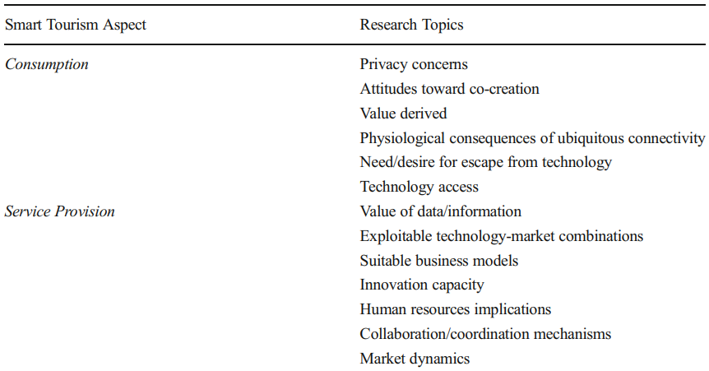
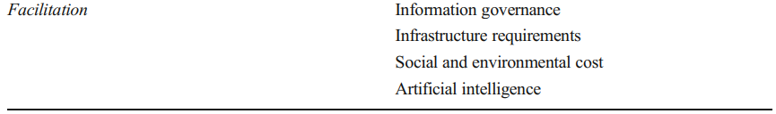
The main research areas identified

Slide 49
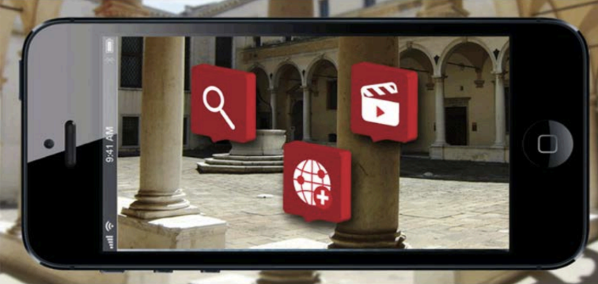
Movio project
As far as the public or public-private level is concerned, we should remember
an Innovative italian project based on digitization of culture.
It’s “movio”, realised by the Istituto centrale per il catalogo unico thanks to the funds of invisible goods by Telecom italia.
Excellences, italian cultural heritage are have been selected in the focus of different cultural events and exhibitions

Slide 50
In Albania - SESC Project example
Interreg IPA CBC ITALME
Smart energy for smart Cities
Objective
Smart energy use education of community in touristic destinations

Slide 51
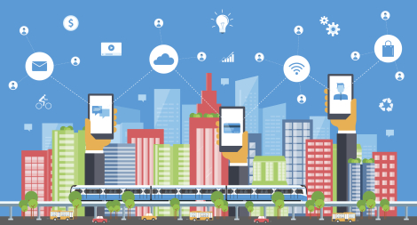
EU Smart Agenda

Slide 52
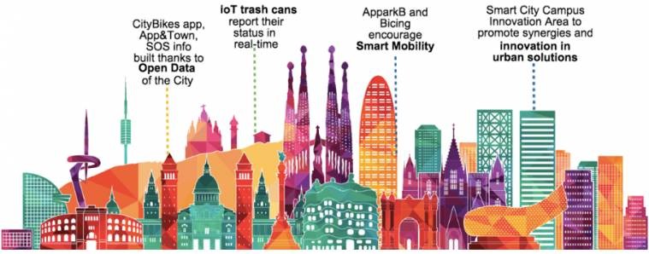
Be Focused on the quality of ST

